Slide 1
HR Analytics Case Study Decode & Curb Attrition
Vijay Mudivedu
Subrat Samant
Abhinav Chandra
Apurv Gaurav

Slide 2
Business Objectives
Problem Statement:
A 4000 employee Company XYZ that has 15% attrition wants identify the factors impacting attrition to reduce the costs as a result of it.
Business Goals:
Find the factors affecting the 15% attrition rate
Express the findings in terms of neat visualizations
Find most important factors leading to attrition to be addressed on priority
Suggest methods of minimizing the cause of attrition

Slide 3
Problem Solving Methodology
Data Sources
Data Preparation
Exploratory Data Analyses
General Data
Employee Survey
Manager Survey Data
In_time_dat, Outtime Data
Analysis of In_Out data frame
Calculate mean attendance, Workload, regularity, Stats
Missing Values, treatment
Outliers and Invalid record treatment
Nominal Categories
Ordinal Categories
Interval Variables
Ratio Variables
Bivariate analysis
Creating Dummy Variables
Variable Transformation
Scaling of variables
Converting variables to factors
Model Building
Model Evaluation
StepAIC method to minimize insignificant variables
Iterating the model variables
VIF values are iteratively measured
Verifying the AIC and p-values of predictors
Sens, Spec, Acc at Cutoff
Gain, Lift and KS-Static verification

Slide 4
Data Preparation & Data Cleaning
Data Preparation:
Employee_survey_data, Manager_survey data, Derived metrics from In_time_data and out_time data, and general_data data frames were merged to collate into employee_master data frame using merge() function.
Data Cleaning:
Preparation of in_out_duration dataframe from from in_data and out_data dataframes.
Computation of derived metrics of each employees mean_attendance, Workload, and Regularity.
Identified the NAs in each of the columns and removed the rows wherever NAs were found.
Performed WOE analysis to impute the NAs “TotalWorkingYears”
Finally, data quality checks of invalid records were followed to get to the employee_master_cleaned dataframe.
Exploratory Data Analysis on the cleaned data to visualize the behavior of continuous variables, categorical variables, Nominal variables, Ordinals, Ratio Values and Interval variable.

Slide 5
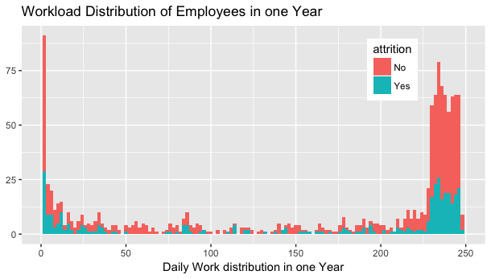
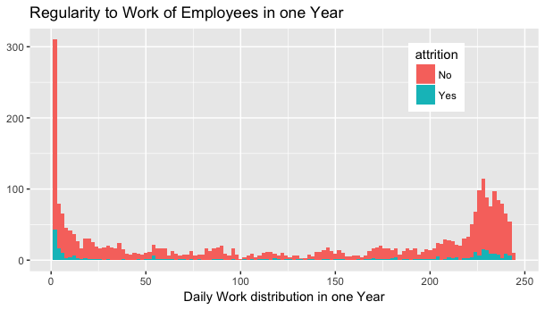
Univariate Analysis – Derived Metrics
50 Percentile of data is spreads across 0 count indicating percentile of overworked
75 percentile is spread across 3 times overworked
Rest fall under 100% overworked.
50% of data is < 20 times in 249 working days
75 % percentile of data is spread across 205 times,
Rest 100% percentile is 249

Slide 6
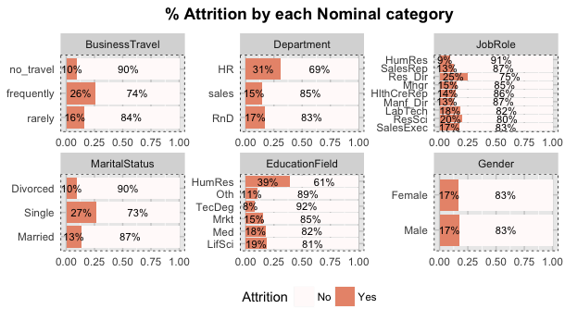
Univariate Analysis – Nominal Variables
Attrition rates:
Single & Married Employees
Employees travelling Frequently and Rarely
HR and R & D Departments
Research Directors, Research Scientists, Lab Technicians
HR degrees, Life Sciences, Medical degrees

Slide 7
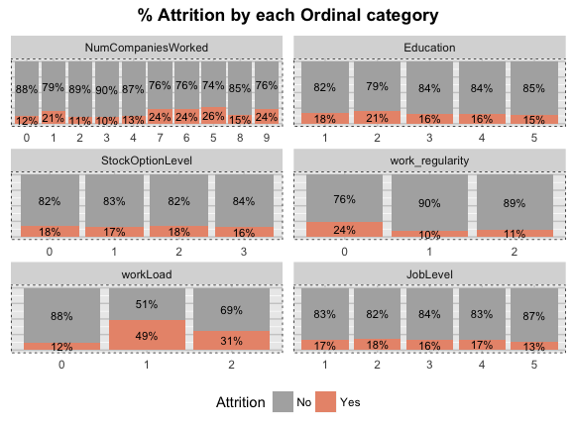
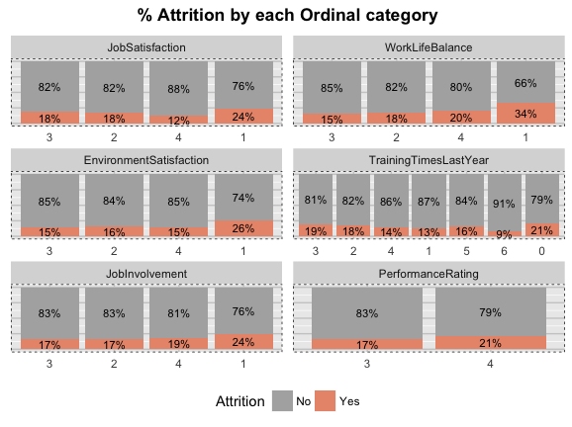
Univariate Analysis – Ordinals
Categories of employees with Low Performance Rating, Lesser Job Involvement, Low Environment Satisfaction, Job Satisifaction, No training received and lesser WorkLifeBalance are more likely part away
Education levels, StockOptionLevels, JobLevels variables do not signify any attrition.
Employes Heavily Worked, and under worked, irregular to work shows higher attrition over other factors indicators.

Slide 8
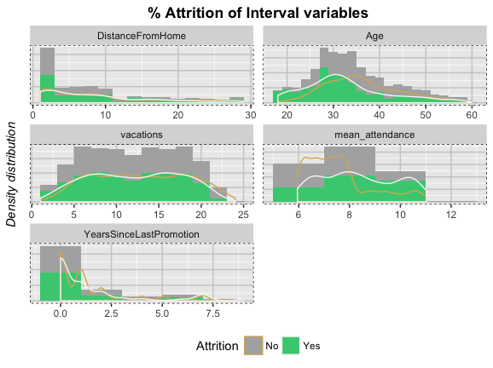
Univariate Analysis – Interval Variables
Attrition rates from Data:
Attrition rates from Data:
Employees in the Age group of 24-35 are highly like to part way
Employees closest to the work location are also like to part away
Mean attendance > 10 or < 7 are the ones that frequently have attrition.
- Employees with no promotion for 7 years, 9 years and 15 years and very likely to part way
- Large portion of this concentrated between 0 to 2.5 years

Slide 9
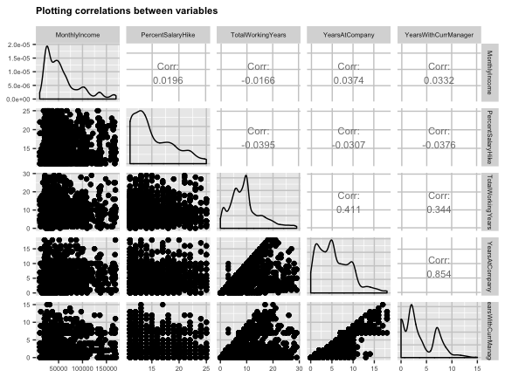
Bivariate Analysis- Ratio Variables
85.4% employees with YearsatCompany work as associated with Currentmanager
41.4% YearsSinceLastPromotion & YearWithCurrManager (44.6%)
Of the total work experience, 41.4% employees spent time in the company

Slide 10
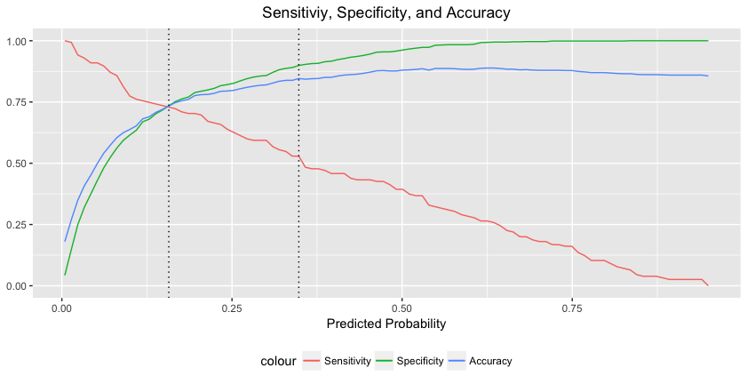
Result – Model Performance
Cuto off - 0.157
Attrition of True Positive or True Negative is 73.3% accurately Predicted by the model.
Model predicts “Yes” Value 72.9% of times among available “Yes”
Also, model predicts “Nos” in 73.43% times of all Nos.
At Cutoff:
Accuracy : 0.7335
Sensitivity : 0.7290
Specificity : 0.7343

Slide 11
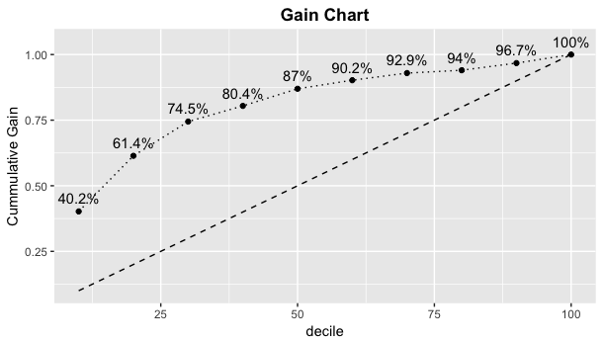
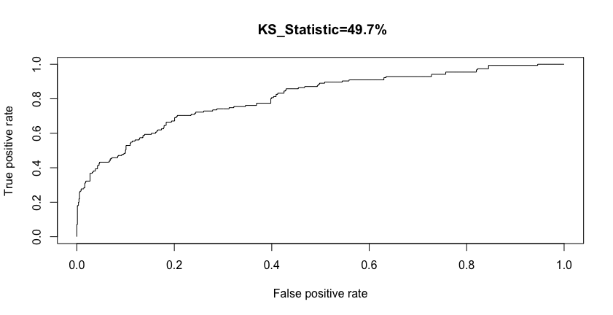
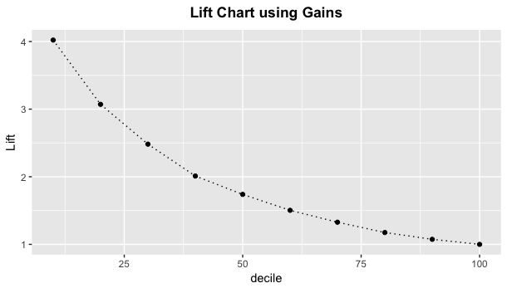
Model Evaluation Gain and Lift Charts
With KS- Statistic 54.7%, Area under the curve is 84%. model has greater ability to predict the Attrition
With Progressive Lift predictive model scales very well against the random model,
With each passing by decile, the gradual rise in cumulative decile scales very well with the model.

Slide 12
Conclusion
Age - Higher Attrition for Lesser Age, It is higher fro the age groups beween 26-35.
Business Travel – Frequently and Rarely,
R&D and Sales Department - have negative relationship with Attrition. The JobRoles of the Department such as Lab Technicians and Research DIrector and Scientists are the one that are frequently looking for moving out.
Employees with Marital_Status Singles are the ones who are frequently look out.
Resources with NumberCompaniesWorked and Total Working Years are Correlated are directly. This impacts the attrition to some extent and the higher the number of companies a resource works, the higher is the attrition. Specifically, between 1 6,7,8
Years with Current Manager and Years Since last promotion are signifcantly correlated with Each other. As an employee works with the CurrentManger attrition is apparently is showing the reduced trend.
Employees with mean_attendance > 10 hours of workload are more prone for lookout and perhaps the reason be a stressful workenvironment and it is clear from the data variables where workload_1 and WorkLoad_2 that demonstrate higher positive values indictor to strong predictors.
Further, employees with poor worklife balance, and poor Job Satisifaction, poor values of Environment Satisfaction and and lower Job_involvment_3 have Higher attrition. Thus there variables have a inverse relationship with attrition.

